Slide 1
Assignment 1
Simon Light

Slide 2
P1/P2
Describe the types of networks available and how they relate to a particular network standards and protocols
Describe why different network standards and protocols are necessary

Slide 3
Different types of networks

Slide 4
PAN (Personal Area Network)
This is the smallest type of network
It transmits between devices
It goes between a range of devices from phones for desktops
Some examples are Bluetooth and a Wi-Fi hotspot

Slide 5
LAN (Local Area Network)
LANs are connected via Ethernet cable or by radio waves (Wi-Fi)
This is often confined to a small office or room, to a whole building
LANs can be connected via cables to create a MAN
This is mainly used for actions such as printing or other types close file sharing

Slide 6
MAN (Metropolitan Area Network)
A MAN is a quite large network.
It is often geographically based (e.g. Reading would make a MAN through lots of LANs).
This is commonly used for any internet browsing (or downloading files) that are hosted within a relatively small geographic area.

Slide 7
WAN (Wide Area Network)
This is the largest type of network.
They are connected through existing telephone systems or satellites.
This can span massive areas and are usually controlled by ISP’s.
This is used when ether there is communication over a large geographic area.
Because of this it is used a lot when browsing the internet and downloading files.

Slide 8
Network Topologies

Slide 9

Ring
Adv:
You wont need a network server to control the connectivity between the machines.
Dis:
Data has to go through all of the nodes making it slow.
This will also make trying to hide data from others on the network harder.
If one node goes down then the whole network will go down

Slide 10
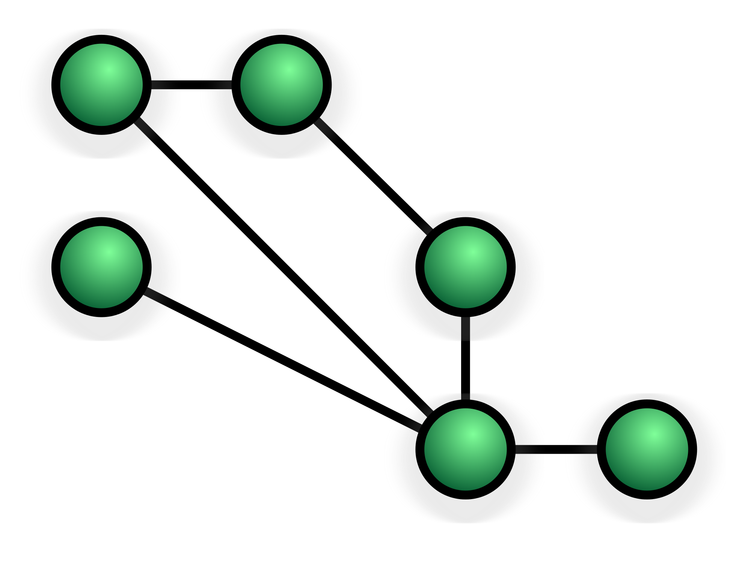
Mesh
Adv:
Adding additional devices wont effect the network connection.
Dis:
If the network is fully connected then it will cost a lot of cabling.
Routing across the network may require a central server.
It hands data across other device, making it insecure.
The method of flooding the network can cause the network to slow.

Slide 11

Fully Connected
Adv:
Data can be transmitted from lots of devices and it can withstand high traffic.
Dis:
It cost the most amount of cable possible.
The amount of cables
Grow at 4 time the size of the network

Slide 12

Line
Adv:
Line is the simplest network and cheapest to install.
Dis:
Data has to go through all of the nodes making it slow.
This will also make trying to hide data from others on the network harder.
If one node goes down then the whole network will go down

Slide 13

Bus
Adv:
You can connect or disconnect computers without disrupting the network.
Dis:
It has a single point of failure, if it goes down so does the rest of the network.
It has a high maintenance cost and a high bandwidth/speed cable is required for the backbone.

Slide 14

Tree
Adv:
You can add additional computers and its easy to do.
Dis:
It has a lot of points of failures all of the network.
This means that all throughout the network you need high speed shielded cabling which is very expensive.

Slide 15

Star
Adv:
You can replace and upgrade from a bridge to a high performance switch.
Dis:
Needs a central server/switch
Has multiple points of shutoff to the rest of the network.
If the central node goes down it is expensive to replace and will close the whole network.

Slide 16
Network Standards

Slide 17
What are standards
Standards are basically a way of doing something. In a network, this is usually a way of sending data across the data.
Standards usually depict speed of transmit, ways the data should be formatted etc.
It is important to decide on a protocol to transmit and receive on before sharing data.
If this is not done then data transmitted will not translated to the same information on the other end.
One example of this may be if one end of the link uses and odd parity bit and the other end uses an even one. This would mean that all of the correct data sent would be seen as incorrect and vice versa.

Slide 18
Example standards: 802.11
This is a set of standard used by Wi-Fi networks. (WLAN)
These protocols all work on the physical layer.
These standards are maintained by the IEEE and it was accepted by them in 1997.
The original 802.11 would not work with modern networks today as the standards have changed.
The modern day version of 802.11 is 802.11n. This combines the 2.4Ghz and 5Ghz standards into a modern day version.
802.11n is the 5th version of the 802.11 family.

Slide 19
Example standards: 802.3
This is the protocol used by Ethernet transmission.
It is again managed by the IEEE.
It works on the physical layer and the data link layer.
It is generally used on local area networks and rarely wide area networks.
Like 802.11, 802.3 is constantly updating
To date there has been over 50 different instalments of it.

Slide 20
Example standards: 802.15.1
This is the standard used by Bluetooth.
Again it is managed by the IEEE.
With 802.15.1, there are multiple different areas of development (around 10) and these areas are brought together into releases of 802.15.1
802.15.1 works between static, moving and fixed devices.
This protocols is only ever used by PAN networks

Slide 21
Network Protocols

Slide 22
What are network protocols?
A protocol is a set of standards that makes up a way of doing something that has high amounts of support.
There are three main types of protocols:
Network Communication Protocols – Basic communication protocols (HTTP, TCP/IP)
Network Security Protocols – Implement security on a network (HTTPS, SSL, SFTP)
Network Management Protocols – Gives network control and overview (SSH, SNMP, ICMP)

Slide 23
Example Protocols: HTTP
HTTP stands for Hyper Text Transfer Protocol.
It is the most basic version of HTTP.
It is used for web pages and can transfer HTML CSS and JavaScript files.
It was developed by Tim Berners Lee in 1989.
It is a request-response system which means that a client has to request a page from the server and then the server will respond with the requested page.
This makes it perfect for webpages as they are not needed until the user goes to the web address.

Slide 24
Example Protocols: HTTPS
HTTPS stands for Hyper Text Transfer Protocol Secure.
This is the same as HTTP but it has an encrypted connection.
This encryption happens on the transport layer.
“The main motivation for HTTPS is authentication of the visited website and protection of the privacy and integrity of the exchanged data”.
It prevents against man-in-the-middle attack and also eavesdropping and snooping.

Slide 25
Example Protocols: SSH
SSH stands for Secure Shell.
It is way of remotely accessing a terminal of another computer.
It is not to be confused with VNC which is a full remote desktop system (SSH only gives access to terminal)
SSH can work over any OS but obviously some OS’s will give better feature than others.
SSH can be used with normal OS security or can be combined with RSA encryption (a key based encryption system).

